Slide 1
FIRST LAW OF THERMODYNAMICS
Dr.Joseph Daniel
SMBS
VIT

Slide 2
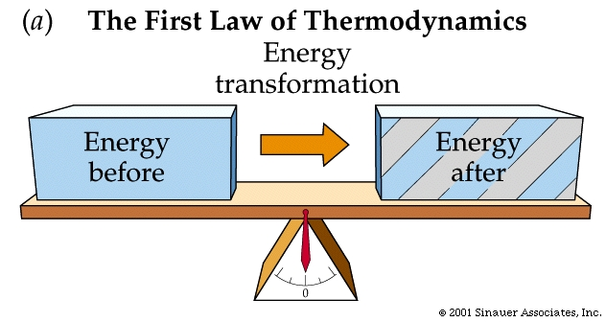
What it implies?
Conservation of Energy principle
Provides a sound basis for studying the relationships among various forms of energy and energy interactions
The postulate is “energy can be neither created nor destroyed but can be converted from one form to the other”
Every bit of energy has to be accounted for.

Slide 3
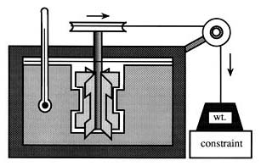
JOULES PADDLE WHEEL EXPERIMENT
Due to work interaction temperature of water increases
Work transferred calculated by fall in height
Known mass of water
Well insulated tank

Slide 4
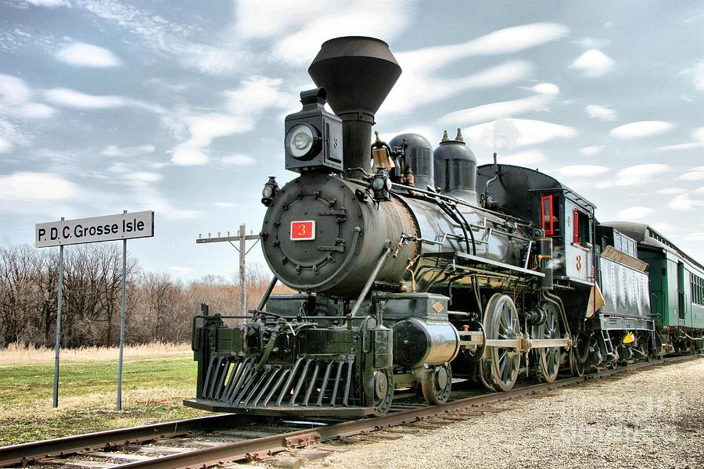
Problem
A locomotive train of 2000 ton mass is driven by the energy generated by burning coal. The train requires a tractive effort of 40 N per ton of its dead mass. What distance the train will travel if it consumes 1000kg of coal and 10 percent of heat generated by burning coal is converted into mechanical work? Calorific value of coal is 32000kJ/kg. What will happen if the engine efficiency is 25%?

Slide 5
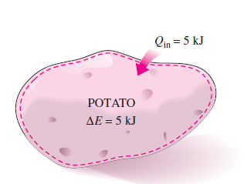
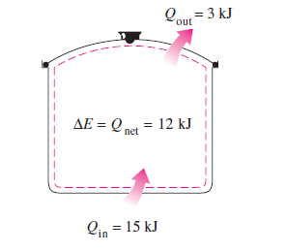
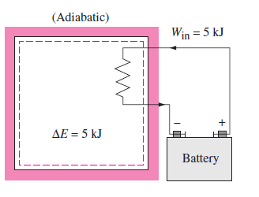
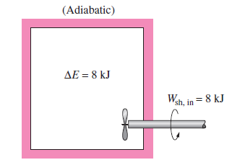
Some day to day examples
Disregarding mass transfer, the increase in total energy equals the heat transferred.
Increase in energy after losses

Slide 6
conclusions
Energy can neither be created nor destroyed but can be conserved.
It can change from one form to the other
Total energy of an isolated system, in all its form remains constant.
All the energy that goes into a system comes out in some other form. Energy cannot vanish.
No machine can produce energy without the expenditure of energy.

Slide 7
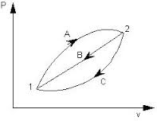

First law for a cyclic process
In cyclic processes the initial and final states are the same or in simple words the initial state is restored.
W₁-W₂=Q₁-Q₂
If a system is taken through a cycle of processes so that it returns to the same state or condition from which it started, the sum of heat and work effects will be zero.

Slide 8
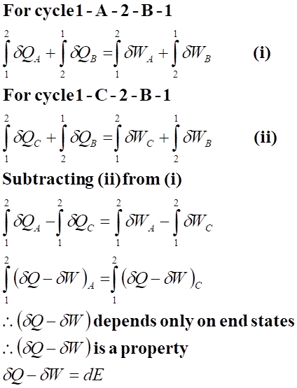
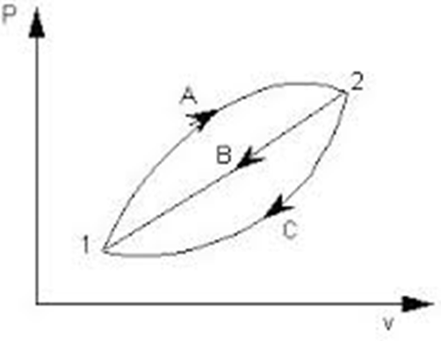

Slide 9
Problem
Consider a steam thermal power plant where the following are the heat and work interactions across the system boundary.
a) power available at the turbine shaft is 600 kW, the feed pump requires 3 kW of work to pump the condensate back to the boiler
b) Steam generation requires 2500 kJ/kg of heat and 1800 kJ/kg of heat is rejected in the condenser cooling water.
Estimate the steam flow rate for this cycle.

Slide 10
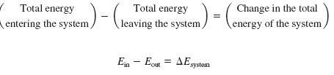
Energy balance
The net change (increase or decrease) in the total energy of the system during a process is equal to the difference between the total energy entering and total energy leaving the system during that process.
This relation mentioned above is often referred as “energy balance”
Used in many Engineering applications if the various forms of energy and methods of energy transfer are fully understood.

Slide 11

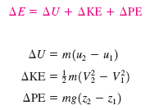
Energy change of a system
The determination of energy change of a system during a process involves the evaluation of energy at the beginning and end of the process.
Energy is a property and the value of property does not change unless the state of the system changes.

Slide 12
Mechanisms of energy transfer
Heat Transfer (Q): Heat transfer increases the energy of the molecules thereby increasing the internal energy of the system. Heat transfer from a system it as energy transferred out as heat coming from the energy of the molecules
Work Transfer (W): .Not due to temperature difference. Work transfer to a system increases the energy and from the system decreases the energy.
Mass Flow (m): Since mass carries energy with it any influx of mass increases the energy and any leaving mass takes away the energy from it

Slide 13
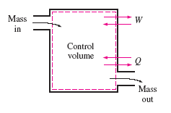
Energy can be transferred as heat, work and mass.
Net transfer of a quantity is equal to the difference between the amount transferred in and out.

Slide 14


Forms of energy equation
Energy balance for any system undergoing any kind of process is expressed as
In the rate form as
Per unit mass basis
In a differential form

Slide 15
Corollaries to 1st law
Corollary 1: When a system executes a process, the net heat interaction equals the net work interaction plus change in the stored energy.
In other words: “there exists a property of a closed system such that a change in its value during any change of state is given by the difference between the heat supplied and work done”
δQ = δW + dE or δQ = δW + dU

Slide 16
Corollary 2: For an isolated system, both heat and work interactions are absent therefore dE = 0 or E= constant.
It indicates that the energy of a system remains unchanged if the system is isolated from the surroundings with respect to heat and work interactions.
“Energy can neither be created nor destroyed but can be converted from one form to the other”

Slide 17
Corollary 3: PMM1: An imaginary device that produces a continuous supply of work without absorbing any energy from the surroundings or from any other systems.
“A perpetual motion machine of the first kind is impossible”

Slide 18
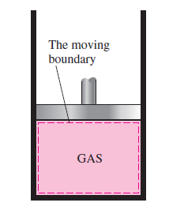
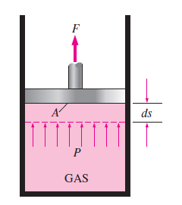


First law applied to closed systems
Moving boundary work
Piston moves back and forth
Called as PdV work
For compressors and Engines
moving boundary work
cannot be determined as
it moves at a greater speed.
The gases cannot maintain
equilibrium.
No process path could be joined

Slide 19
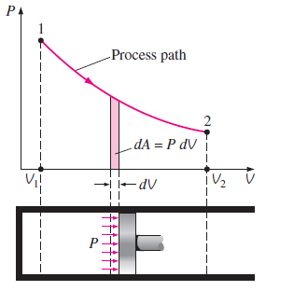

The area under the process curve on a P-V diagram is equal in magnitude to the work done in a quasi equilibrium expansion or compression process of a closed system.

Slide 20
Various types
Constant Volume - Isochoric
Constant Pressure - Isobaric
Constant Temperature - Isothermal
Reversible Adiabatic
Polytropic Process

Slide 21
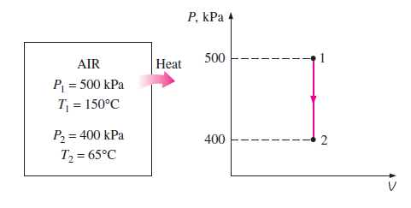
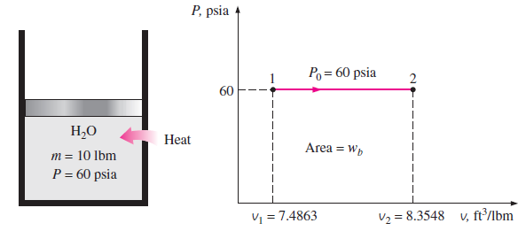
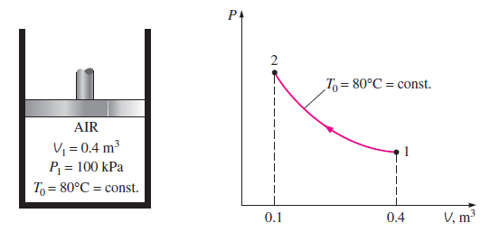
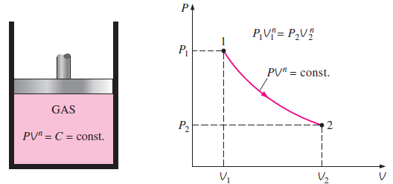
Constant Volume
Constant Pressure
Constant Temperature
Polytropic Process

Slide 22
Constant Volume process
Change in state of a system at constant volume
Gas system is heated or cooled in an enclosed space
Both pressure and temperature changes.
Pressure and temperature increases when heat is supplied to the system.
St line parallel to the axis of pressure.
Area under the curve is zero (No work)

Slide 23
Constant Pressure process
Change in state at constant pressure.
Piston cylinder assembly and piston loaded with a constant weight.
The gaseous system is supplied with heat.
Piston moves upwards under constant pressure slowly and passes through a series of equilibrium positions maintaining constant intensity of pressure.
Both volume and temperature changes

Slide 24
Problem
There was a farewell party in a hall where 25 people attended it. The hall size was 10 X 8 X 5 m. Each person gives up about 350 kJ of heat per hour. Assuming that the room is sealed off completely and insulated. Calculate the air temperature rise with in a span of 10 minutes. Assume C_{v}=0.718 kJ/kg.K , R= 0.287 kJ/kg.K and each person occupies a volume of 0.05 m³

Slide 25
Problem
In a vessel, 10 kg of O₂ is heated in a non flow constant volume, so that the pressure of O₂ is increased two times that of initial value. The initial temperature is 20ºC. Calculate the final temperature, change in internal energy, change in enthalpy and heat transfer. Take R=0.259 kJ/kg.K and C_{v} = 0.625 kJ/kg.K for oxygen.

Slide 26
Problem
100 liters of Hydrogen gas at 300 K temperature and 5 bar pressure is contained in a cylinder fitted with a frictionless piston. The piston carries a dead weight, can move freely and its upper part id exposed to atmospheric pressure. Identify this process. There is input of paddle work to the gas and its temperature rises to 350 K. Evaluate a) Work done b) change in internal energy and enthalpy c) paddle work input.

Slide 27
A 25 cm diameter cylinder is fitted with a frictionless piston which is loaded with 1200 N weight. Initially the piston is 30 cm above the bottom end and the space beneath the piston has CO₂ at 290 K temp. The gas is supplied with a heater of 1 W power. Assuming no heat loss, evaluate the distance through which piston will be pushed outwards during this heating period of 1 hour. Take barometric pressure eq to 1 bar. C_{p}= 820 J/kg.K, R = 189 J/kg.K

Slide 28
Isothermal Process.
Piston cylinder arrangement surrounded by a constant temperature reservoir.
When an ideal gas inside the cylinder is at temp T at any instant of time, there exists a thermal equilibrium between the system and the surroundings.
When the piston moves outwards the gas expands and temperature falls by an amount dT.
Heat flows from the reservoir to the gas until its original temperature is restored.

